Slide 1


Sales & Customer Analysis
Project Phase - 3
Group Name: Data Vizards
Members:
Muskan Garg
Vatsal Gohel

Slide 2
TABLE OF CONTENTS
01
Overview
02
Research Question
03
Graphs and Insights
04
Recommendations
05
Conclusion

Slide 3
Overview
Achieving success in a fast-paced world of e-commerce, where online shopping has become the new norm, requires an understanding of customer behavior, which is key to the success of a business. This dataset of sales contains information about orders placed by customers on an e-commerce website. The dataset has a total of 286,392 entries with 36 columns. Our project is Sales and Customer analysis to uncover fascinating insights that shed light on consumer behavior and trends.

Slide 4

Research Questions
What are the overall sales trends in all categories? How is the distribution of statuses of different orders determined (received, complete, refunded, canceled)?
What is the preferred method of payment for customers? Are there any differences in the preferences of payment methods between individuals based on the demographics such as gender or age?
How much is the average discount percentage applied to orders? Does high discount values make certain categories sell fast?
Does the performance of sales in each region differ from the performance in other regions? Are there particular cities, counties, states, or regions that play a significant role in contributing to sales?
Is there an impact of discounts on the overall revenue of a company? What is the overall of total sales over time? How is discounts offered over time affect sales?

Slide 5
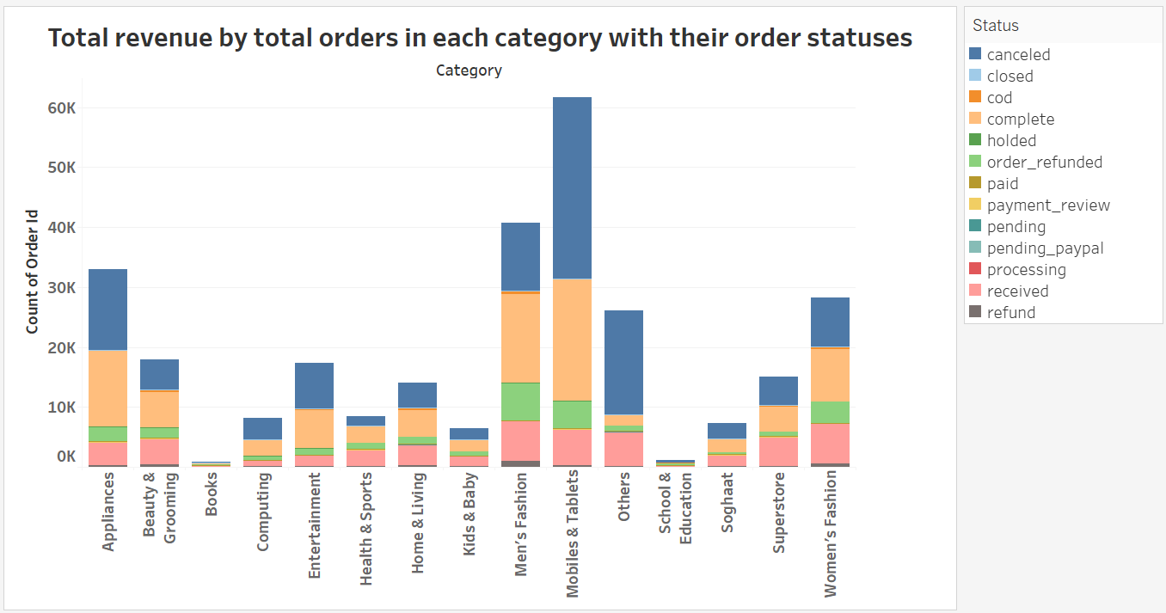
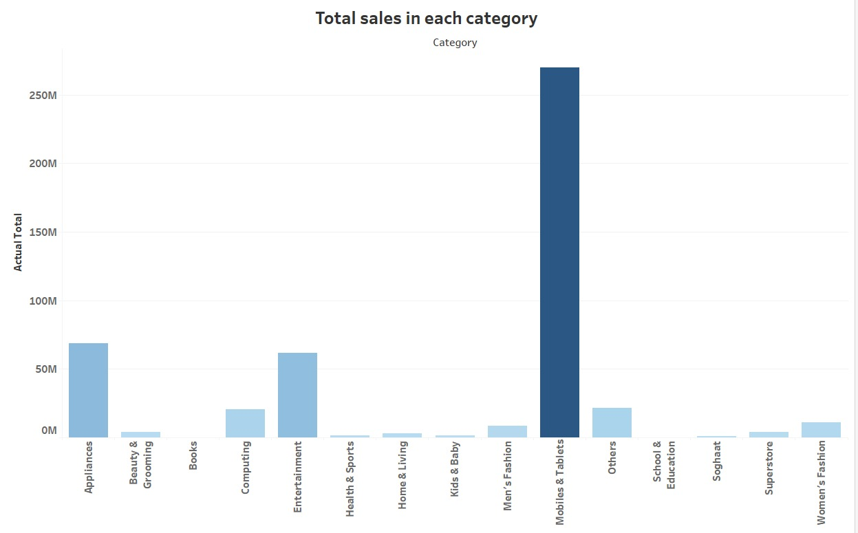
Total revenue by total orders in each category with their order statuses
Analyzing each category gave us few fascinating facts, how most sold category has the greatest number of cancelled orders which is concerning and to overcome that sellers need to make sure better qualities such as in electronics so as not to loose on business and wasting human resources and potential. Overall, Quality must not be compromised to overcome the fact that products with cancelled status after complete status are overpowering.

Slide 6
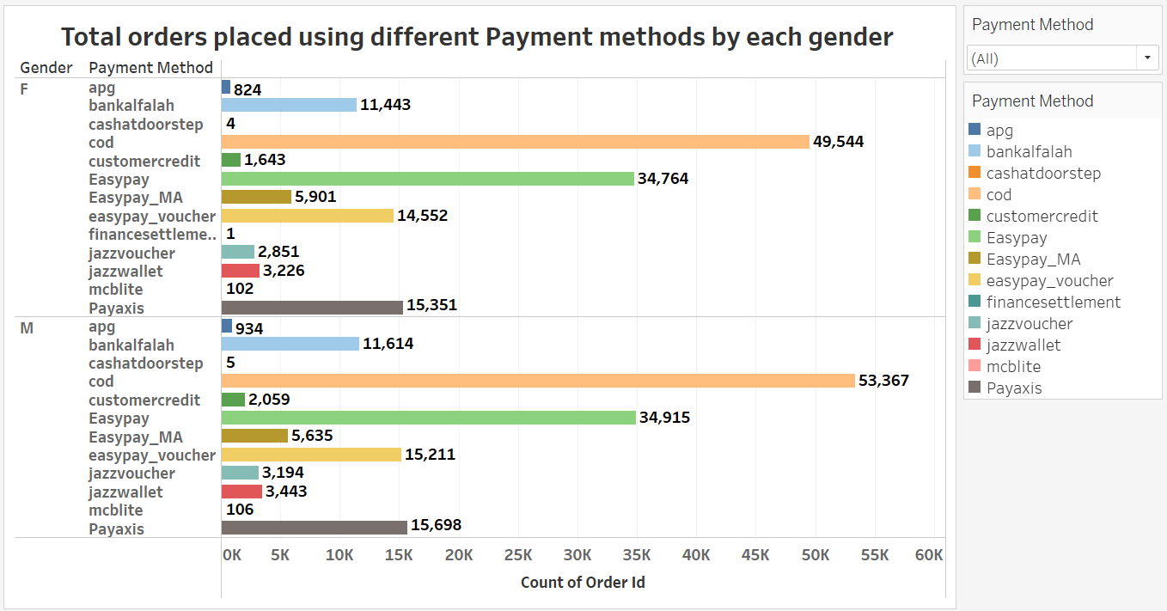
Total orders placed using different Payment methods by each gender
The traditional Cash on Delivery (COD) method remains popular despite the digitalization of payments. It challenges the assumption that all customers prefer digital payments. Adapting to the reasons behind this preference for COD, businesses can provide a seamless and trustworthy buying experience, accommodating old-school preferences of some customers while still incorporating modern conveniences. Also, an interesting fact gender distribution does not really affect customer behavior.

Slide 7
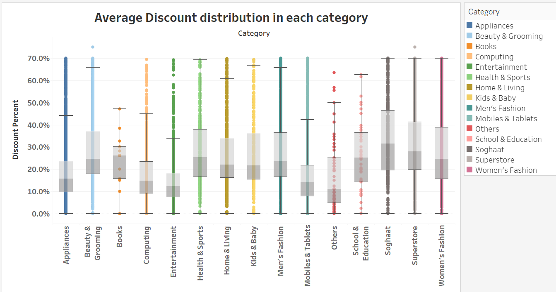
Average Discount distribution in each category
Discounts greatly varies in each category. Ironically, most sellable category doesn’t have high discount distribution which says that discounts doesn’t affect sales and revenues. Although, here we see Soghaat category was offered higher discounts, it shows customer behavior to go for gifts on discounts. It helps e-commerce to put shelf items on discounts so to make them sell fast. Sellers don’t have to have great inventories, just need to have variety products put on discounts.

Slide 8
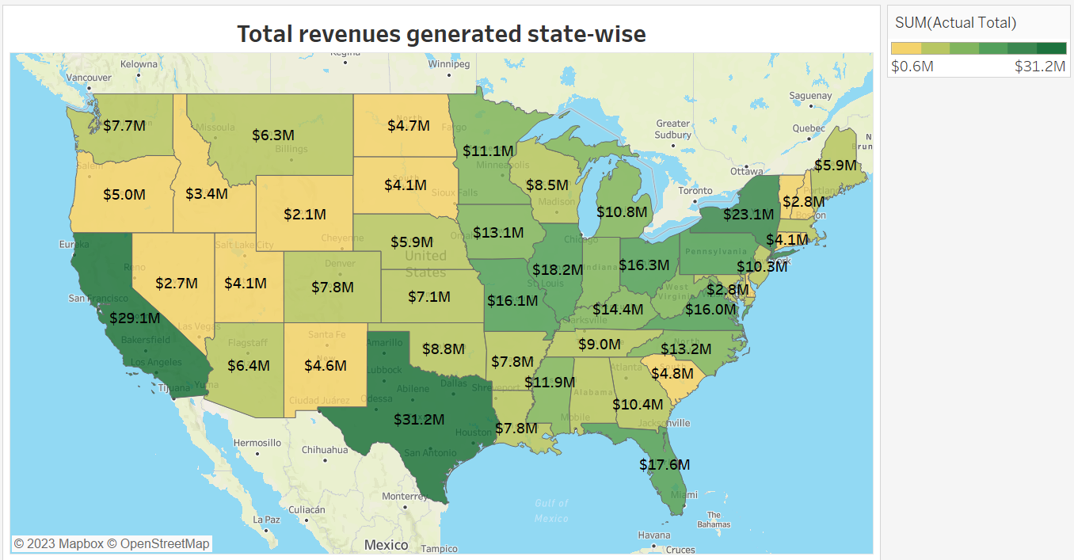
Total revenues generated state-wise
State-wise distribution provides a big picture on how our e-commerce website is helping make business in different parts. Clearly, Texas produces highest sales gives rise to an in-store opportunity to expand business on both platforms. Multiple campaigns/surveys can be done in this direction on granular level to find out the most suitable locations to start a chain of the in-store outlets.

Slide 9
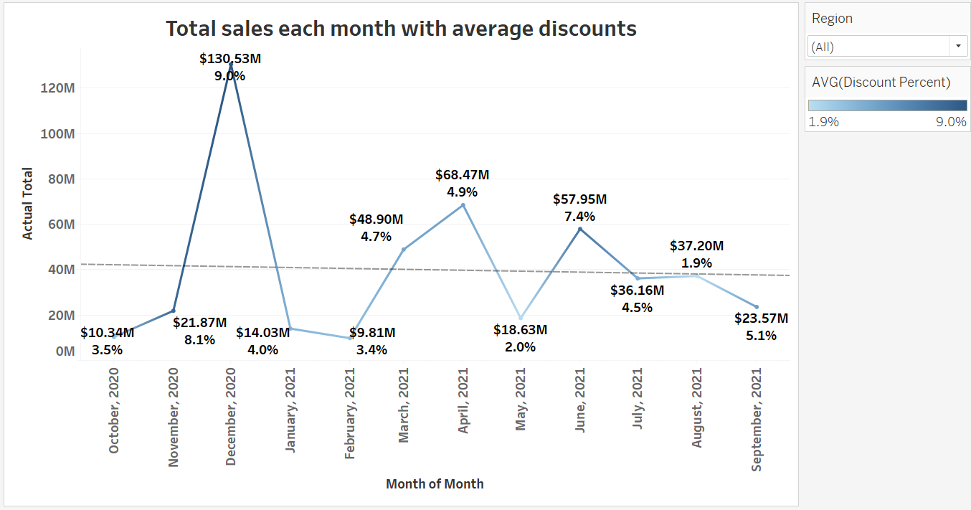
Total sales each month with average discounts
Over time trend is constant with slight downwardness. Although, we could see the highest sales are in the month of December owing to festivities like Christmas. Offering greater discount can help rise in sales and revenues. Also, to open an in-store outlets, August is the apt time, so to have ample time to be fully prepared in the prime time to make good sales for the store in an extended way.

Slide 10

Recommendations
We can evaluate pricing strategies after analyzing sales. Inventory management, product pricing, marketing campaigns, and customer service can all be improved by understanding market trends and sales. Analyzing the trends of which categories are more likely to be sold or recommended in more attractive ways, so that they can be stacked or recommended in a way that makes them more readily accessible to consumers.
E-commerce sales patterns can change over time, so it's crucial to regularly update our analysis and forecasts as new data becomes available. Continuously monitor the accuracy and reliability of our predictions and adjusting our strategies accordingly. Periodically reassessing our models and assumptions to ensure they remain valid and up-to-date. We can consider incorporating external data sources or market research to complement our analysis and ensuring our forecasts and recommendations reflect the current business environment.

Slide 11

Conclusion
Our dataset provides insight into gender-related customer behavior, discount percentages' impact on sales, and the predominance of Cash on Delivery over other payment methods. These insights help businesses develop targeted marketing strategies, optimize pricing, discounting, and payment options to cater to diverse customer preferences. Take advantage of this valuable knowledge to drive growth, enhance customer satisfaction, and secure a competitive edge.
This analysis helps us understand customer behavior and a selling pattern for an e-commerce website. It gives rise to an opportunity to expand the business in realms of offline old school Markets too. More external features like sold products, external campaigns could have helped this analysis in a better way to know in-out of an e-commerce website to make high margin business.

Slide 12



THANKS!

